Slide 1
Searching
Dian Nursantika
Sistem Informasi
FMIPA
Universitas Terbuka

Slide 2
Referensi
Videos of http://geeksforgeeks.com/

Slide 3
Isi
Binary Search

Slide 4
Searching
Pencarian dalam array dapat diterapkan dengan cara, mencari nilai yang paling sesuai dengan data yang dicari.
Jika data tersebut berada pada array, maka data ditemukan dan akan memberikan data tersebut ada diindeks berapa.
Jika data tersebut tidak ada pada array, maka diberikan nilai -1 dan data tersebut tidak dapat ditemukan.

Slide 5

Binary Search Code
// Java code for linearly searching x in arr[]. If x
// is present then return its location, otherwise
// return -1
class GFG
{
public static int search(int arr[], int x)
{
int n = arr.length;
for(int i = 0; i < n; i++)
{
if(arr[i] == x)
return i;
}
return -1;
}
public static void main(String args[])
{
int arr[] = { 2, 3, 4, 10, 40 };
int x = 10;
int result = search(arr, x);
if(result == -1)
System.out.print("Element is not present in array");
else
System.out.print("Element is present at index " + result);
}
}
Output

Slide 6
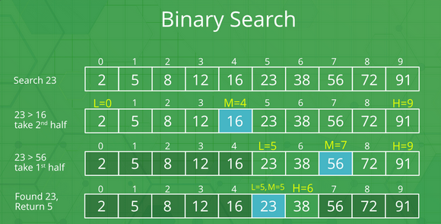
Binary Search

Slide 7
Binary Search Code
// Java implementation of recursive Binary Search
class BinarySearch {
// Returns index of x if it is present in arr[l..
// r], else return -1
int binarySearch(int arr[], int l, int r, int x)
{
if (r >= l) {
int mid = l + (r - l) / 2;
// If the element is present at the
// middle itself
if (arr[mid] == x)
return mid;
// If element is smaller than mid, then
// it can only be present in left subarray
if (arr[mid] > x)
return binarySearch(arr, l, mid - 1, x);
// Else the element can only be present
// in right subarray
return binarySearch(arr, mid + 1, r, x);
}
// We reach here when element is not present
// in array
return -1;
}

Slide 8
Binary Search Code Lanjutan
// Driver method to test above
public static void main(String args[])
{
BinarySearch ob = new BinarySearch();
int arr[] = { 2, 3, 4, 10, 40 };
int n = arr.length;
int x = 10;
int result = ob.binarySearch(arr, 0, n - 1, x);
if (result == -1)
System.out.println("Element not present");
else
System.out.println("Element found at index " + result);
}
}
/* This code is contributed by Rajat Mishra */
Output

Slide 9
Penutup
Semoga ilmunya bermanfaat.
Sampai berjumpa lagi di inisiasi berikutnya Struktur Data

